Slide 1
Microsoft Azure Machine Learning
Eduard van Valkenburg
Big Data Consultant
Notes:
Good afternoon everyone!
I’m really excited to talk to you today about Windows Azure.
We launched Windows Azure two years ago, and since that time we’ve enhanced it regularly with new features and capabilities.
Today we are announcing our most significant release yet. Today’s release elevates Azure to a new level, opens it up to even more developers, and is designed to power the next generation of applications.

Slide 2
Topics
Wat is Machine Learning?
Wanneer kan je Machine Learning gebruiken?
Introducing Azure Machine Learning
Azure ML 4 Developers
Demo!

Slide 3
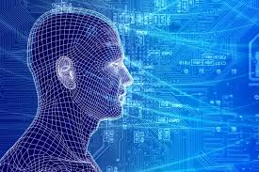
Machine Learning
Computing systems that improve with experience
Notes:
The goal of machine learning is to build computer systems that can adapt and learn from their experience.” – Tom Dietterich from

Slide 4
Why Learn?
Learn it when you can’t code it (e.g. Recognizing Speech/image/gestures)
Learn it when you can’t scale it (e.g. Recommendations, Spam & Fraud detection)
Learn it when you have to adapt/personalize (e.g. Predictive typing)
Learn it when you can’t track it (e.g. AI gaming, robot control)

Slide 5
What is Machine Learning?
Methods and Systems that …
Adapt based on recorded data
Predict new data based on recorded data
Optimize an action given a utility function
Extract hidden structure from the data
Summarize data into concise descriptions

Slide 6
Machine Learning is not
Methods and Systems that …
perform good predictions without data modeling & feature engineering
Silver-bullet for all data-driven tasks – it’s a powerful data tool!
are a replacement for business rules – they augment them!
can yield Garbage-In-Knowledge-Out

Slide 7
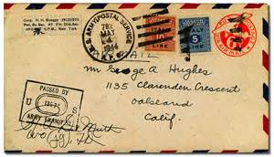


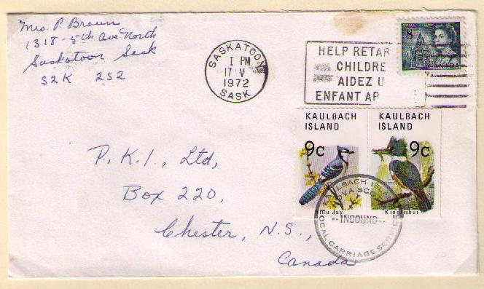
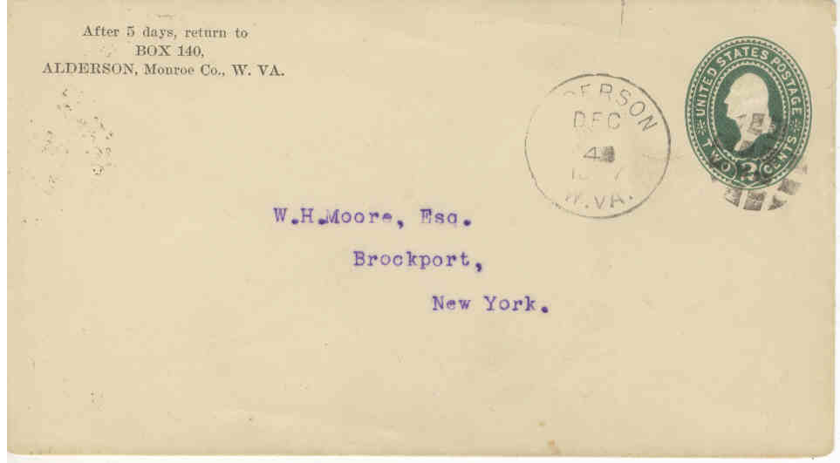

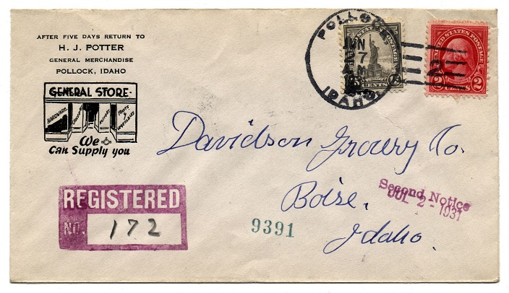
Notes:
As some of you may already know, one of the classic early applications of ML was to handwriting recognition. [click]
Before ML, problems like this involved having human programmers develop and code up sets of rules to recognize letters and digits. While such an approach may have limited success in very narrow domains with highly restricted inputs, [click] coping with the scale and diversity of the real world proves, in practice, to be extremely difficult.
Throughout the 1970’s and 1980’s, early systems were brittle in practice. Not only was the recognition accuracy poor, but the system behavior would change in unpredictable ways whenever the rules were extended or revised.

Slide 8
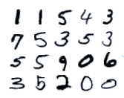
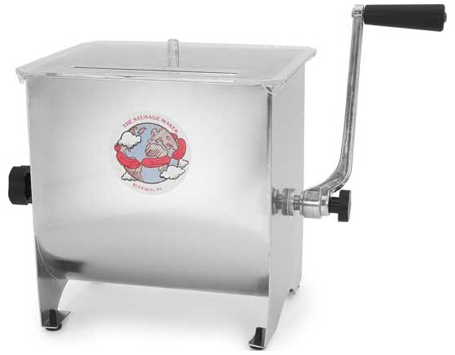
1 | 1 | 5 | 4 | 3
7 | 5 | 3 | 5 | 3
5 | 5 | 9 | 0 | 6
3 | 5 | 2 | 0 | 0
Training examples
Training labels
Accurate digit classifier
2
Machine learning system
Notes:
ML takes a different approach. By applying concepts from a range of fields, including statistics, probability theory, and so on, we can build an ML system that “learns” to recognize handwritten digits by being trained on thousands, or even millions, of examples.
So, in order to get an accurate digit classifier, all we need to do is acquire lots of training examples, with labels (this is called “labeled training data”), and then feed it into the ML system.

Slide 9

Notes:
Of course, OCR today is powered by machine learning. For example, the Bing Translator app (developed by MSR) uses ML-powered OCR.

Slide 10
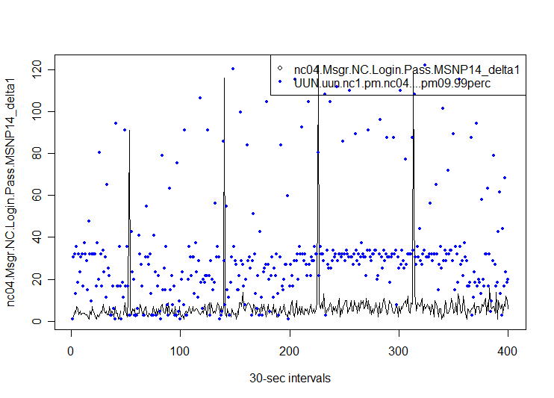
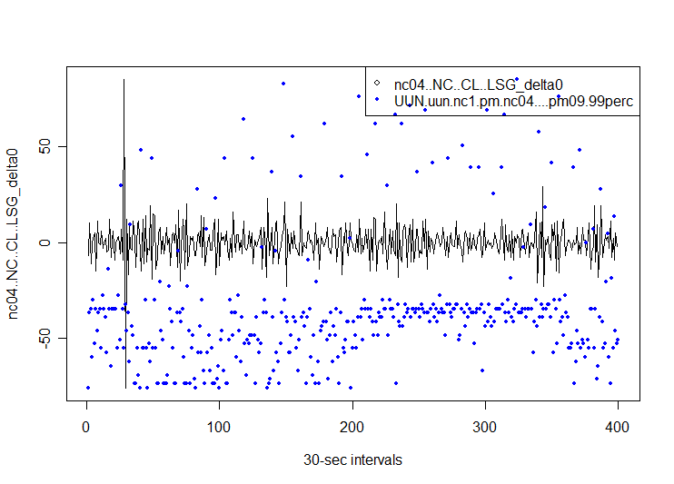
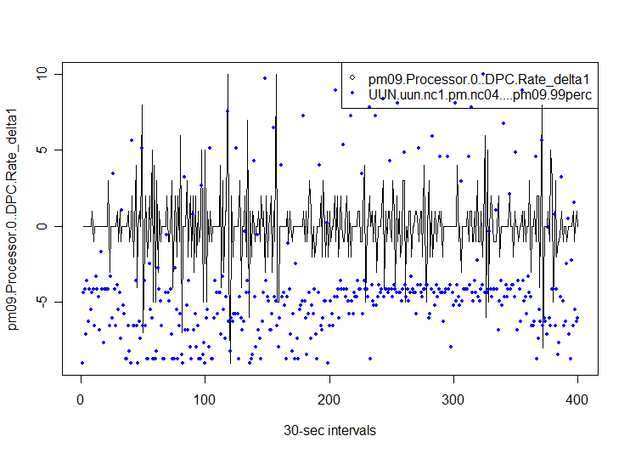
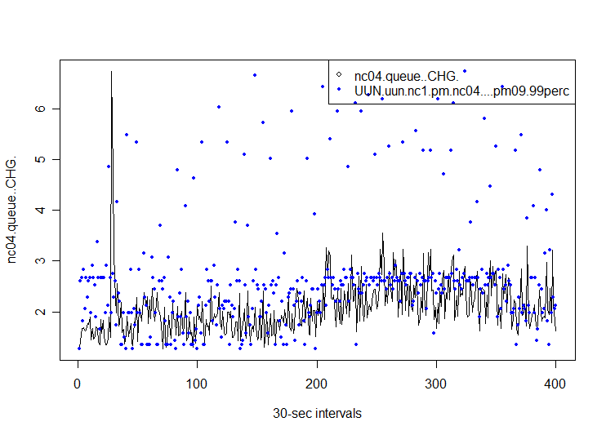
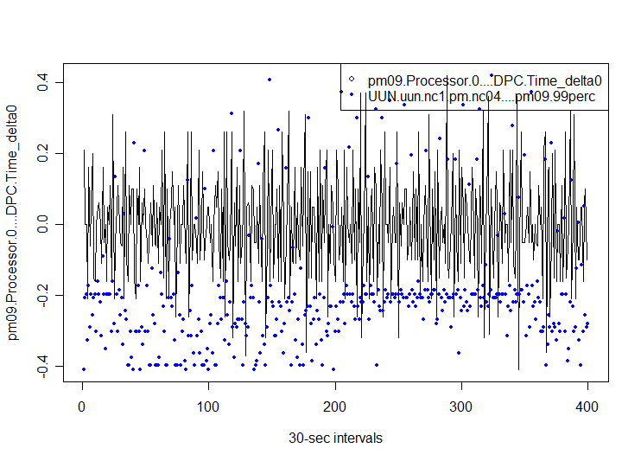
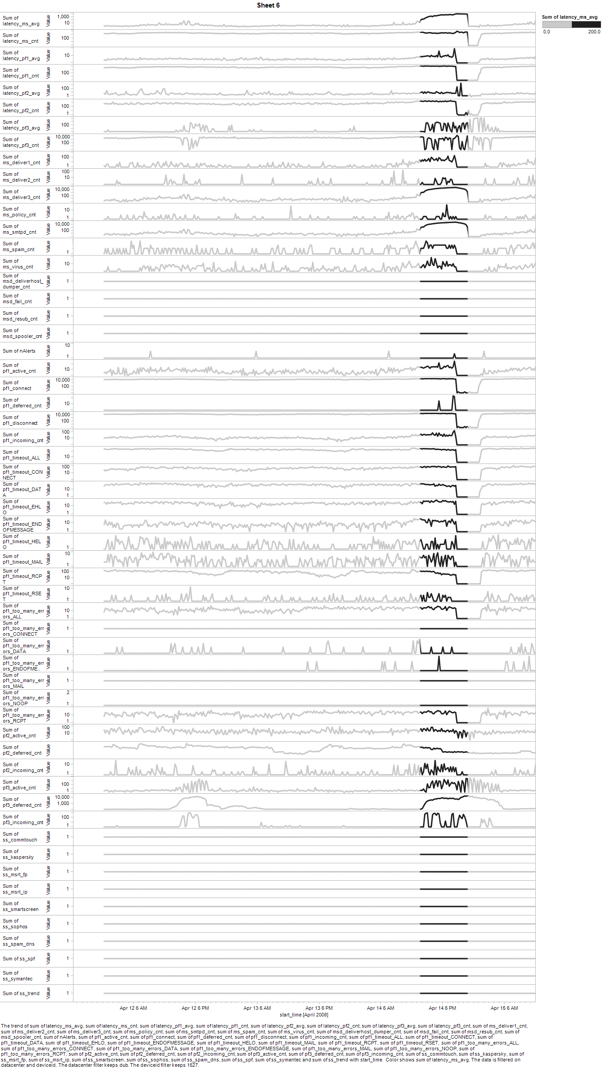
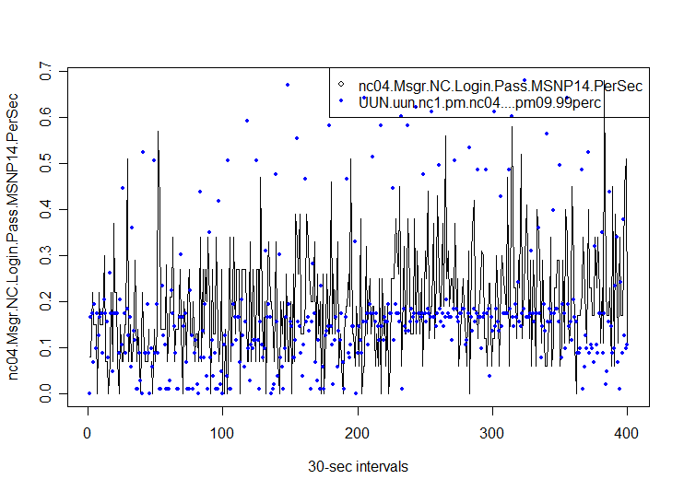
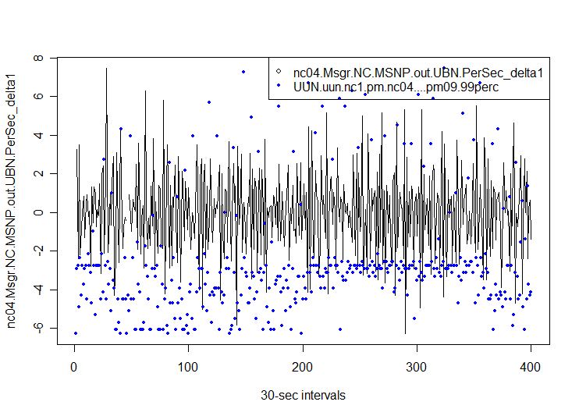
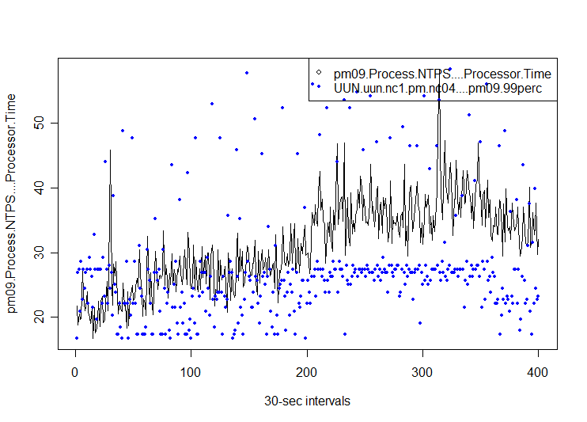
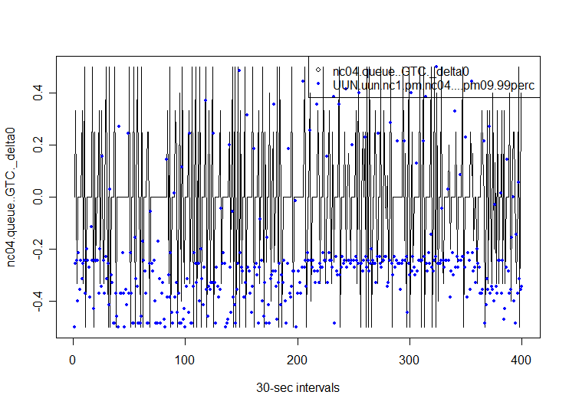
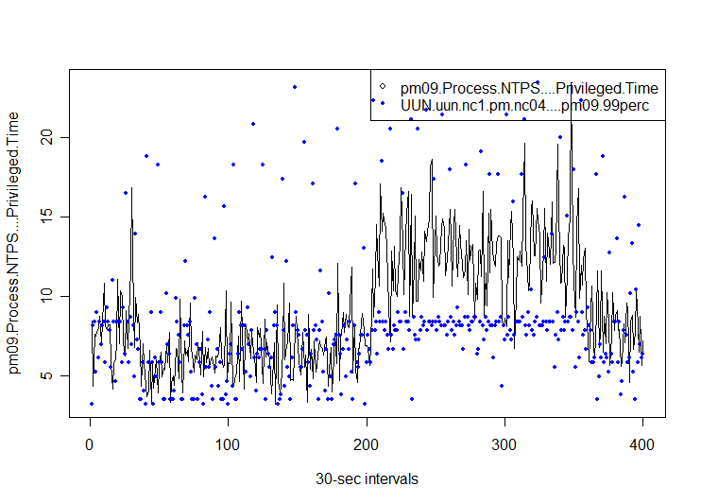
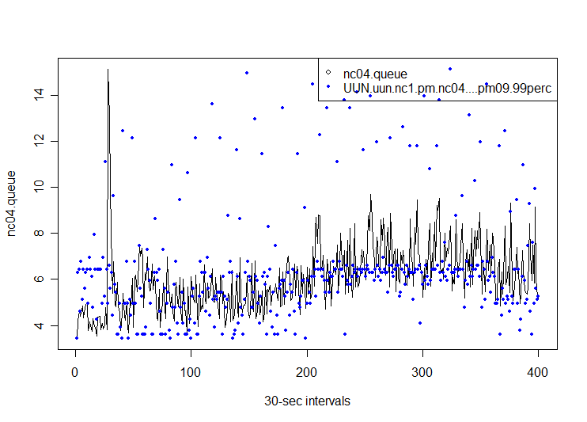
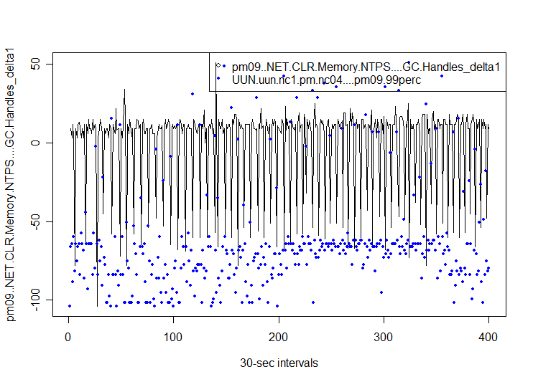
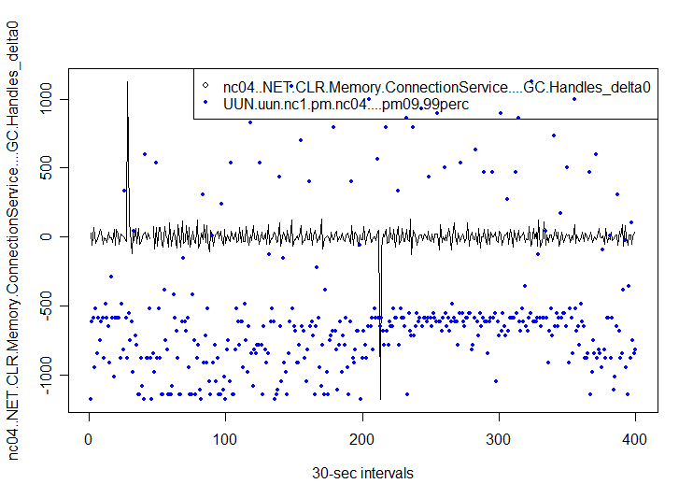
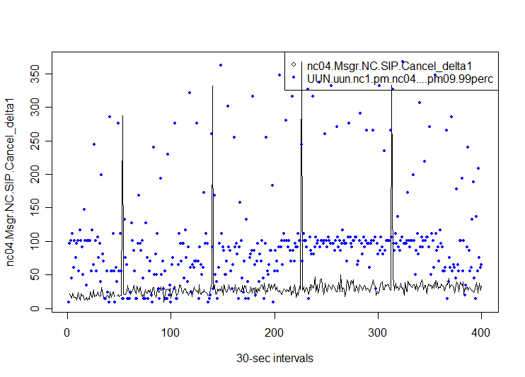
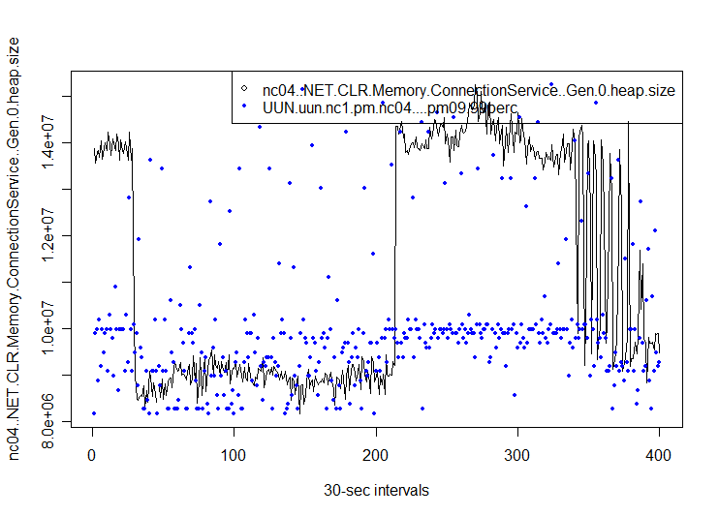
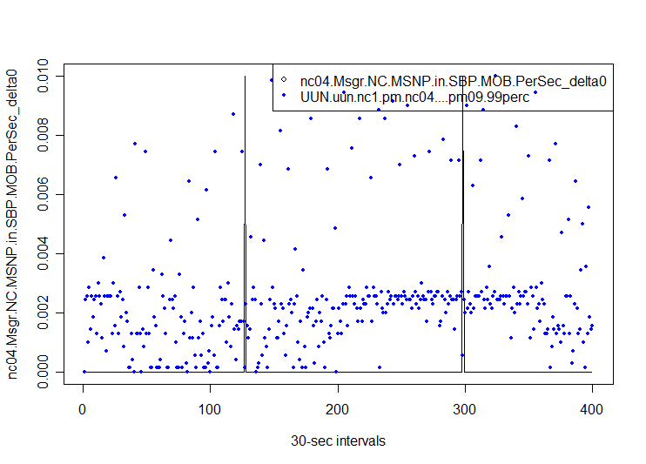
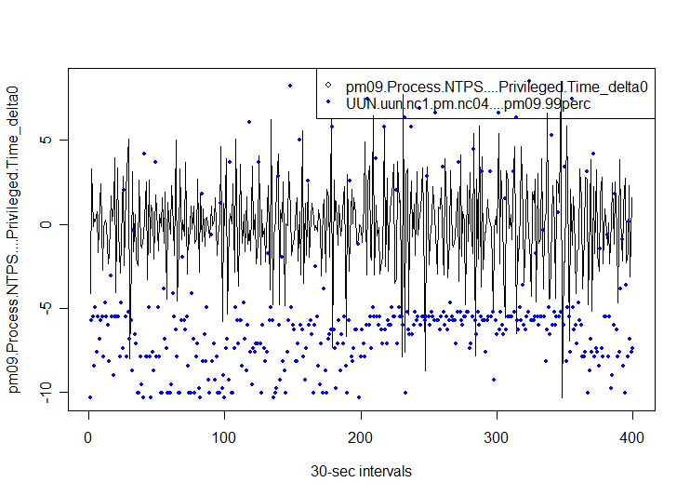
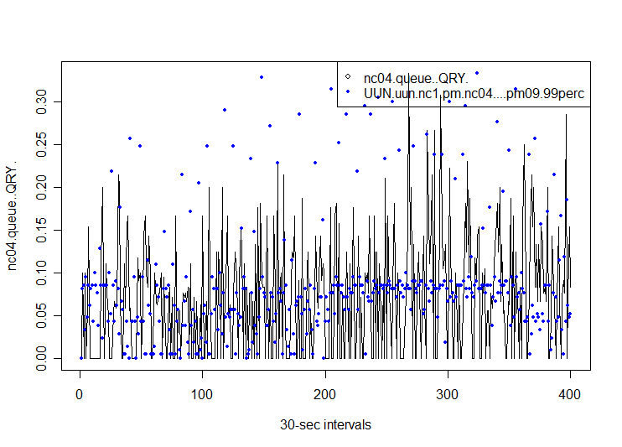
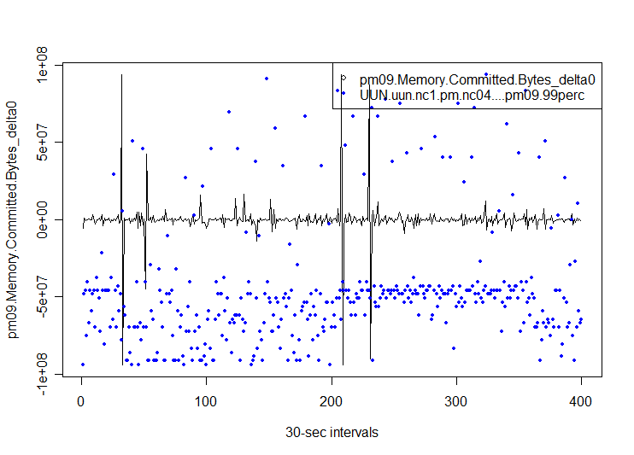
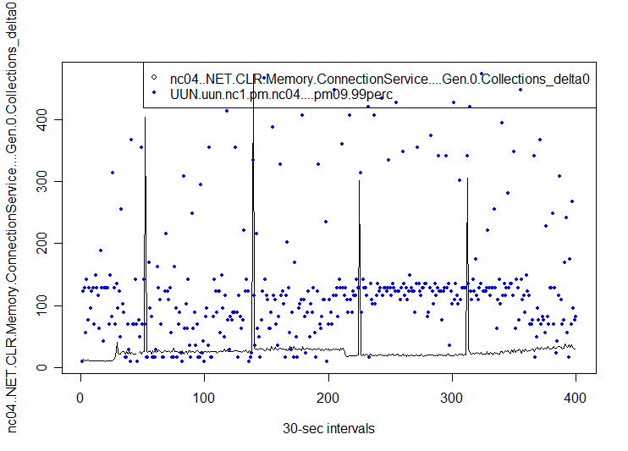
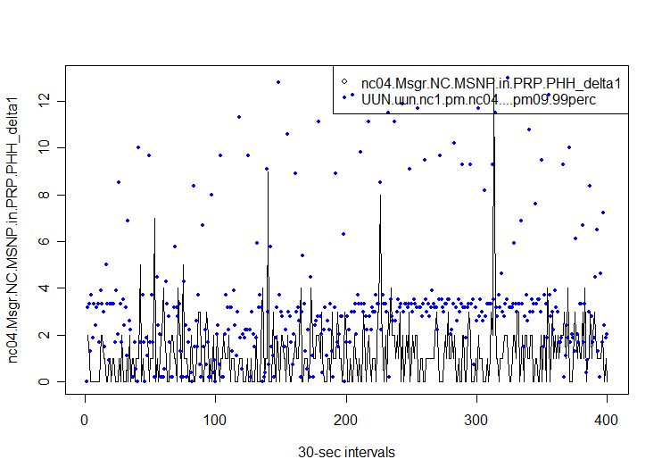
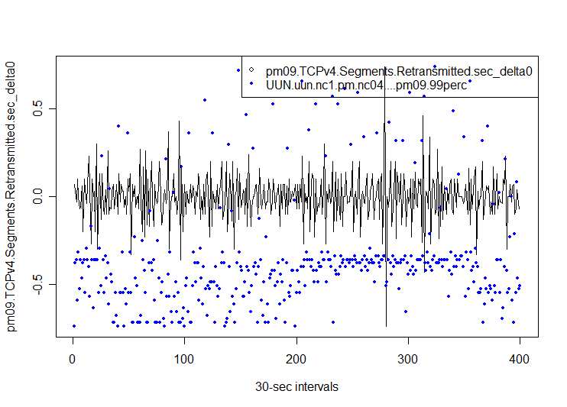
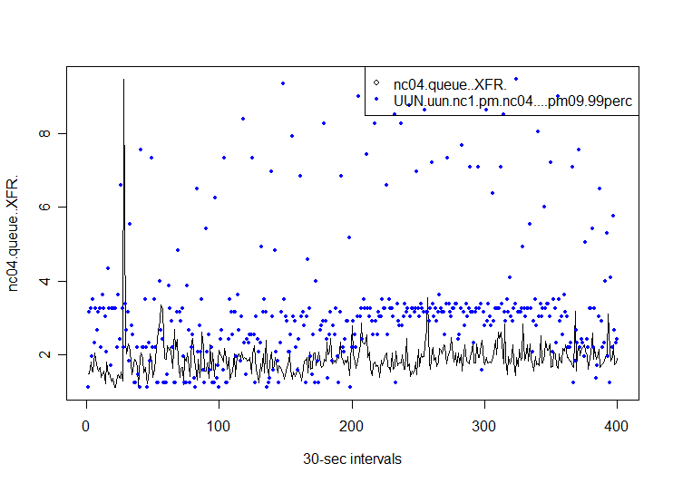
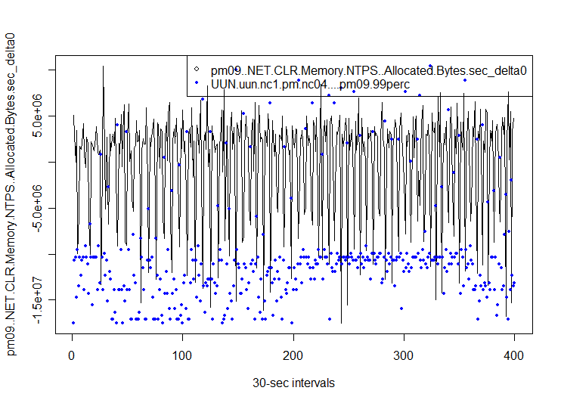
Hundreds of thousands of machines…
Hundreds of metrics and signals per machine…
Which signals correlate with the real cause of a problem?
How can we extract effective repair actions?
Notes:
For another example of Big Data and ML, consider this real data from Exchange Hosted Services, running in a major datacenter in Dublin.
Operators DC designers etc, are smart and by and large have key performance indicators that would alarm when things are not ok. Yet the problem is that we still need to find how to fix the problem. The perf indicators are usually related to throughput or response time per transaction, etc.
There is far too much raw data for humans to handle. Machine learning is the solution to automatically extract actionable information, in a scalable and adaptive way.
With respect to the last point, in one demo/challenge with Exchange Hosted Services they had put as part of the signals some of their own alarms. None were picked up by our algorithms. They were surprised so we visualized the signals and indeed they were not correlated with the problems. The explanation is that those alarms were set some time ago and they failed to adapt to different machines/workloads.
In this particular case, we use ML to extract signatures/fingerprint of problems (fingerprint is a succinct representation of problems in terms of its metrics), then we cluster these fingerprints and use the clustering to find recurrent problems.
Our techniques also helped with the diagnosis of the problem in Dublin (the exact one you are watching). Summary: the main correlate was an indicator that a pipeline to another datacenter was backing up. Initially our engineers thought that it was a problem of workload capacity so they ignored that signal and added capacity. Our system showed that after that the correlation only increased. Further investigation showed that indeed it was the backing up of the other datacenter that was forcing redistribution of load and driving machines beyond capacity…

Slide 11
Machine Learning: Setting
gender | age | smoker | eye color
male | 19 | yes | green
female | 44 | yes | gray
male | 49 | yes | blue
male | 12 | no | brown
female | 37 | no | brown
female | 60 | no | brown
male | 44 | no | blue
female | 27 | yes | brown
female | 51 | yes | green
female | 81 | yes | gray
male | 22 | yes | brown
male | 29 | no | blue
lung cancer
no
yes
yes
no
no
yes
no
no
yes
no
no
no
Train
ML Model
male | 77 | yes | gray
male | 19 | yes | green
female | 44 | no | gray
?
?
?

Slide 12
Machine Learning: Setting
gender | age | smoker | eye color
male | 19 | yes | green
female | 44 | yes | gray
male | 49 | yes | blue
male | 12 | no | brown
female | 37 | no | brown
female | 60 | no | brown
male | 44 | no | blue
female | 27 | yes | brown
female | 51 | yes | green
female | 81 | yes | gray
male | 22 | yes | brown
male | 29 | no | blue
lung cancer
no
yes
yes
no
no
yes
no
no
yes
no
no
no
Train
ML Model
male | 77 | yes | gray
male | 19 | yes | green
female | 44 | no | gray
yes
no
no
Notes:
We know that supervised machine learning models can predict one field in your data from some or all of the others (the input fields). But how does the model building process actually work? All machine learning algorithms (the ones that build the models) basically consist of the following three things:
- A set of possible models to look thorough
- A way to test whether a model is good
A clever way to find a really good model with only a few test
You want to find a good restaurant without having to eat at every single one. How best to be clever about it? Maybe you take a look at the menu, or the outside of the building, or the surrounding neighborhood. Maybe you ask some people you trust. In any case, you know a lot of tricks that will let you find a good restaurant without trying all of them. You may not find the best one; that would be a lot more work, and is probably not necessary. But you could probably find one that’s pretty good.
Unfortunately, even with this fairly simple idea, there are many ways that learning algorithms fail, and things you can do to make sure they don’t.

Slide 13
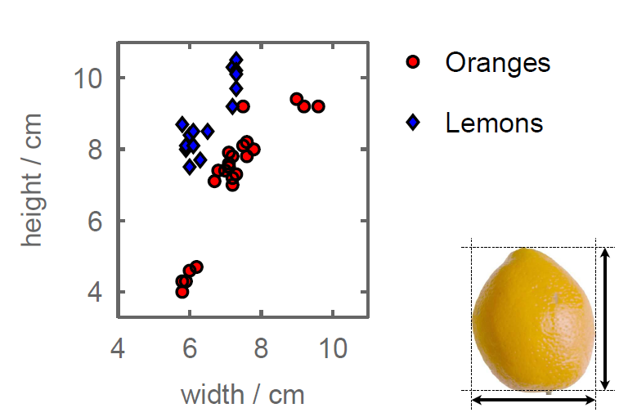
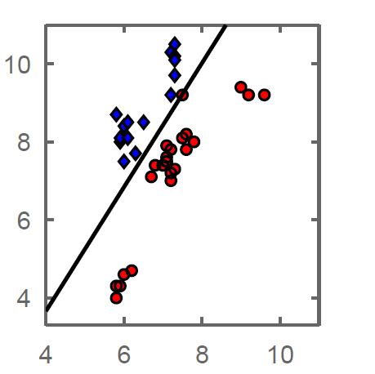
A Two Dimensional Space

Slide 14
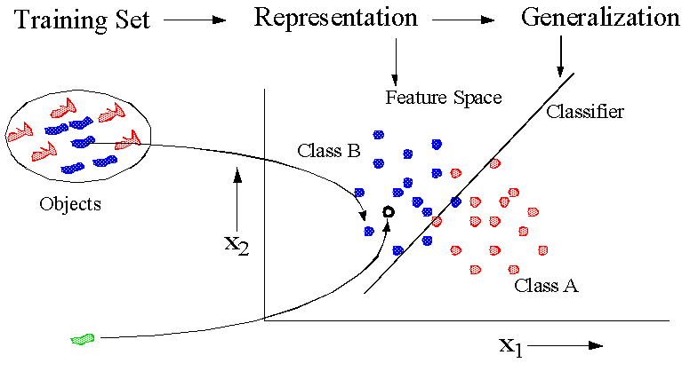
Learning From Data
Source: http://prlab.tudelft.nl/content/pattern-recognition
Notes:
Basic concept of pattern recognition

Slide 15
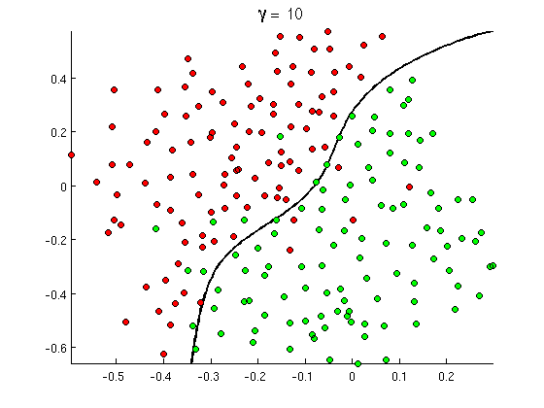
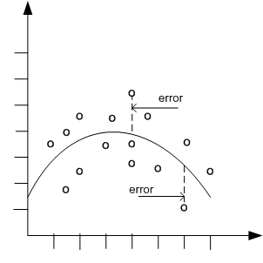

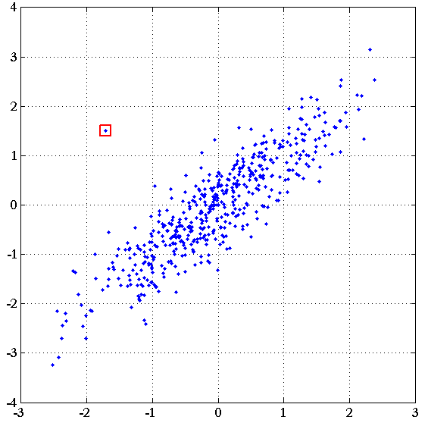
Common Classes of Problems
Classification
Regression
Recommenders
Anomaly
Detection
Notes:
http://openclassroom.stanford.edu/MainFolder/courses/MachineLearning/exercises/ex8materials/ex8b_10.png
http://docs.oracle.com/cd/B28359_01/datamine.111/b28129/img/scatter_plot_nonlinear.gif
http://spectrum.ieee.org/img/RecommendNEWf1-1348253703748.jpg

Slide 16
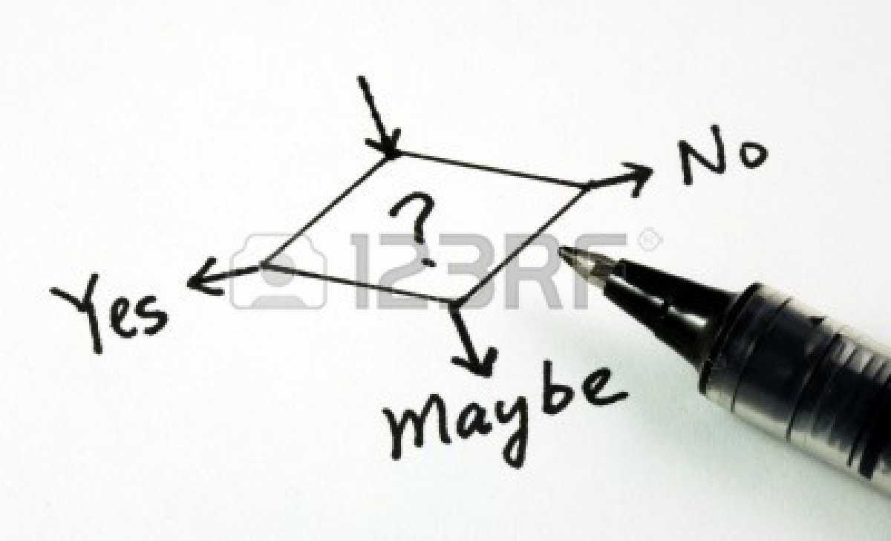

Requirements for Problem solving with ML
Valuable business problem involving decision
Existing process
Metrics
Available data
Related to the decision
Historical
Outcomes
Notes:
http://us.123rf.com/400wm/400/400/johnkwan/johnkwan1008/johnkwan100800099/7596302-yes-no-or-maybe-concepts-of-making-business-decision.jpg

Slide 17
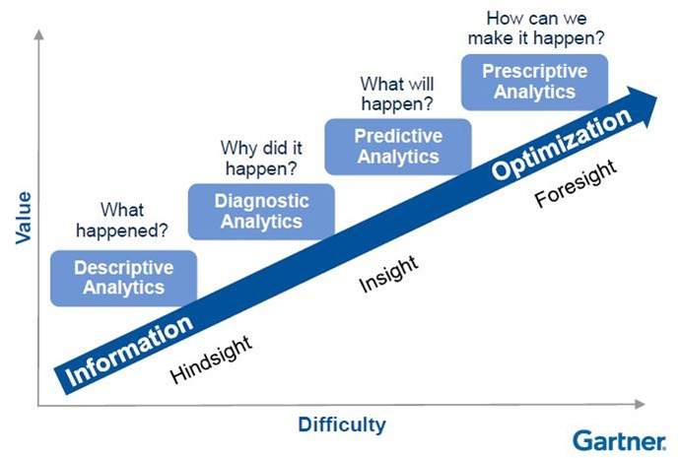
Types of Analytics
Traditional BI
Deployed ML
Notes:
See http://www.biganalytics2013.com/presentations/Neil-Raden-Big-Data-Analytics-The-Art-of-Data-Science.pdf – p7

Slide 18
solve extremely hard problems better
extract more value from Big Data
ML allows us to
approach human intelligence
drive a shift in business analytics
Notes:
So we can see that ML can make it possible to solve extremely hard problems – problems that otherwise might be beyond our abilities to program up. In this sense, ML is a powerful new tool for software engineering.
But the impact of ML goes beyond software development. ML is the key to extracting more value from Big Data and capturing human intelligence. It is also central in how we approach advanced analytics at Microsoft

Slide 19

Data Science Complexity
Data Science is far too complex today
Access to quality ML algorithms, cost is high.
Must learn multiple tools to go end2end,
from data acquisition, cleaning and prep,
machine learning, and experimentation.
Ability to put a model into production.
This must get simpler, it simply won’t scale!

Slide 20


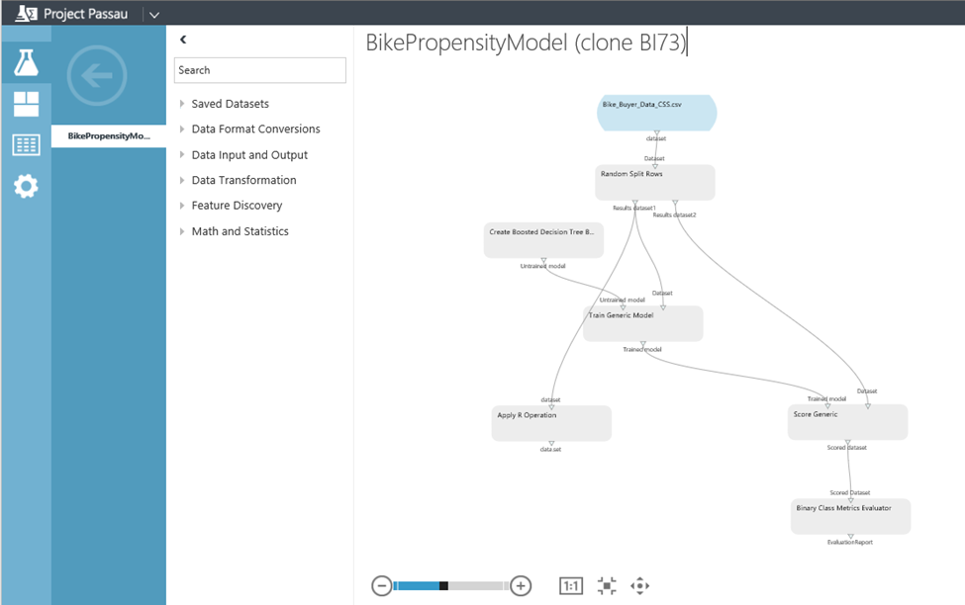
Microsoft Azure Machine Learning Features and Benefits
Reduce complexity to broaden participation
Accessible through a web browser, no software to install;
Collaborative work with anyone, anywhere via Azure workspace
Visual composition with end2end support for data science workflow;
Best in class ML algorithms;
Extensible, support for R OSS.

Slide 21
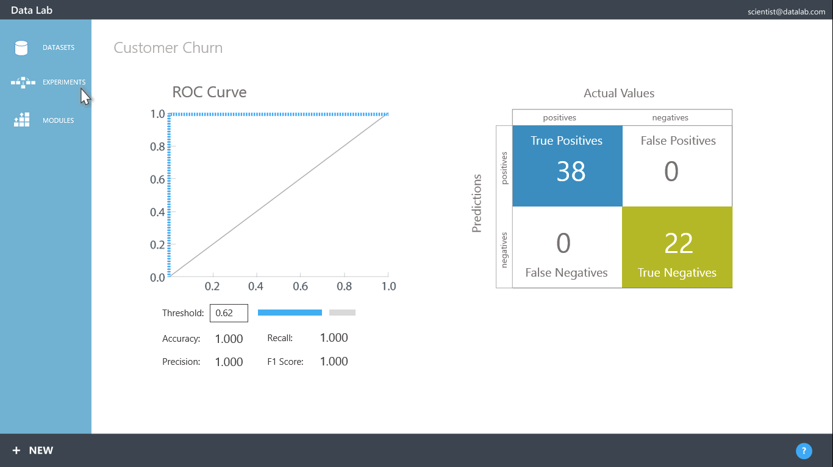
Microsoft Azure Machine Learning Features and Benefits
Rapid experimentation to create a better model
Immutable library of models, search discover and reuse;
Rapidly try a range of features, ML algorithms and modeling strategies;
Quickly deploy model as Azure web service to our ML API service.

Slide 22

Anomaly Detection for SQL Azure

Slide 23
Business Problem & Data
Goal
SQL Azure monitors its health through several error and performance counters.
The goal is to detect any changes in the normal behavior of these counters and raise alerts.
Data
We are tracking 120 counters for 12 SQL Azure clusters
Each counter is aggregated every 15 mins and the algorithm looks at 2 weeks of data at a time.

Slide 24
Approach
Upload the data to Sql Azure DB for AzureML pipeline
Use strangeness function for detecting extreme values.
Run change detection on the latest 2 week data every ½ hour.
Send alerts based on anomaly scores

Slide 25
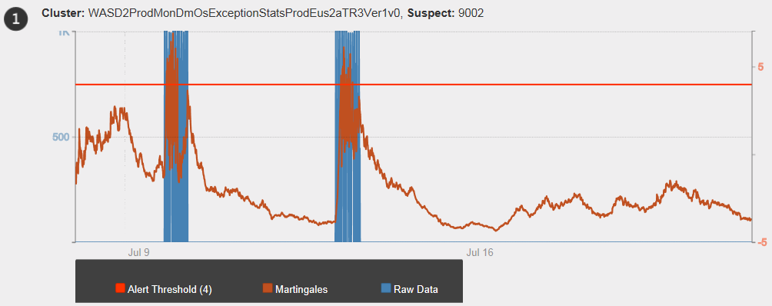
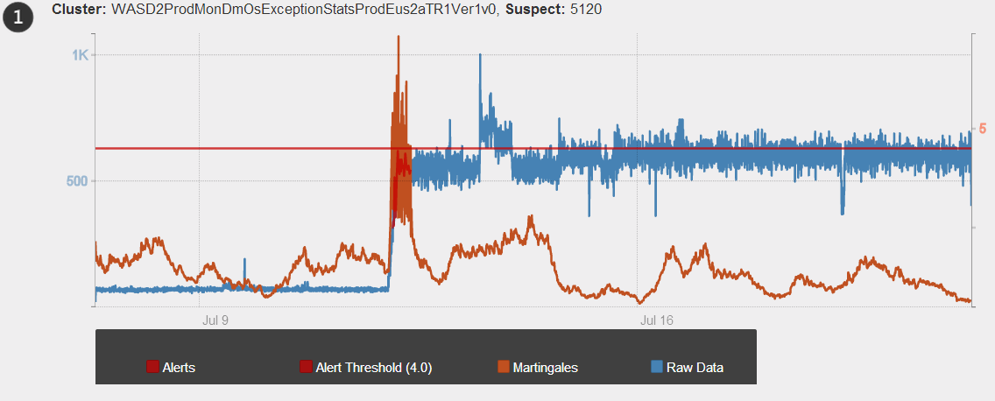
Results
Currently the Anomaly detection is running live on production data on a schedule
Alerts are generated based on anomaly score.
A couple of critical alerts caught by this system that were not caught by the previous R based production system.
The above charts show raw data with the anomaly scores. The alerts are raised when the scores cross the threshold.

Slide 26
Azure Machine Learning - vision
Vision:
Make machine learning (ML) accessible to every enterprise, data scientist, developer,
information worker, consumer, and device anywhere in the world.
ML Marketplace: a marketplace/appstore for intelligent web services where an external customer can come and consume web service applications that are relevant to their business.
ML operationalization: a cloud service that can host a massive selection of intelligent web services, automatically scaling. You can put any machine learning model into production by a single click.
ML Studio: a easy to use browser-based solution for rapid building and experimenting with predictive models.
ML Algorithms – best in class ML Algorithms and models
ML Operationalization
ML Studio
ML Algo
ML Applications Marketplace

Slide 27



Steps to build a ML Solution
1
De/Refine business problem
5
Monitor model’s performance
2
Extract data
1
Define Target / Metric
5
Evaluate Model
2
Extract Derived Features
4
Deploy model
3
Develop model through iterations
4
Fit Model
3
Select Features
Notes:
Source:
AIP DataLab.pdf page 3
Deep Dive on Big Data.pptx by Val Fontama(slide 10)
To be fully effective, organizations need to build predictive analytics into ongoing business processes so the results can be used in real time. While the market demands deployable predictions, it also requires the ability to frequently update the model to respond to changes in business conditions, new threats and/or opportunities, or simply improve a predictive model.
This slide explains a five steps process/workflow to build a predictive model:
Business Problem identification
Data Preparation
Iterative Model Development
Deploy Model /Operationalize
Monitor Model’s Performance
Business Problem –
A retail Bank uses a credit scorecard every day to issue new loans or monitor performance of existing loans
To be competitive the Bank needs to aggressively acquire new customers, but limit the risk of default
A Credit scorecard is used to maximize profit by accepting the largest pool of customers who will pay their debt.
A credit scorecard is a predictive model used to predict likelihood of default.
2 Data Preparation-
2a) Identify & acquire data((In-house business/IT, consultant, 3’rd party data providers)
Banks’s credit data
Payment history data from credit bureaux
Demographic data from 3rd party
2b) Clean, Shape, Pre-process Data (In-house IT, consultant, community)
MSFT tools: Data Explorer, Project Passau
3 Iterative Model Development
3a) Author or Select Model
Use MSFT or 3’rd party solution (e.g. SAS); OR
Author own model; OR
Outsource model to community
MSFT tools: Project Passau Authoring Tool
3b) Train & Evaluate Model
Model trained on large subset of data & evaluated on smaller subset
Logistic Regression is de facto standard
MSFT: Project Passau Machine Learning Service
Deploy Model /Operationalize
4a) Scorecard Deployment
Represent the model as a formula
Implement the model in Bank’s scoring tool
Integrate model outputs into apps for use by Bank’s staff or Partners
Most deployments will be on-premises
4b) Scorecard Monitoring
Continuously monitor scorecard’s performance for performance on new customers
Alert Analysts once the model starts underperforming
MSFT: Project Passau Hosting of Operational Models
5 Monitor model’s performance
Solution identifies
Customers most likely to default
When a scorecard is underperforming due to changes in customer patterns, invalid assumptions, etc.
As a result the Bank can reject applicants with high risk of default
Results:
25% Growth in revenue, but 10% Drop in delinquency

Slide 28
Demo

Slide 29
Feature engineering is the key…
“easily the most important factor” in determining the success of a machine learning project – and he’s right…

Slide 30
Feature engineering is the key…
Construct a model that can predict for any two cities whether the distance is drivable or not.
Probably not going to happen...
Notes:
The problem here is that no single input field, or even any single pair of fields, is closely correlated with the objective. It is a combination of all four fields (the distance from one pair of geo-coordinates to the other), and a combination by a fairly complex formula, that is correlated with the input. Machine learning algorithms are limited in the way they can combine input fields; if they weren’t, they could totally exhaust themselves trying everything.

Slide 31
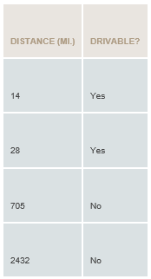
Feature engineering is the key…
Even if the machine doesn’t have knowledge of longitudes and latitudes work, you do. So why don’t you do it?
Feature engineering, when you use your knowledge about the data to create fields that make machine learning algorithms work better.
How does one engineer a good feature? Rule of thumb is to try to design features where the likelihood of a certain class goes up monotonically with the value of the field.
Great things happen in machine learning when human and machine work together, combining a person’s knowledge of how to create relevant features from the data with the machine’s talent for optimization..
Notes:
I would say an average of 70% of the project’s time goes into feature engineering, 20% goes towards figuring out what comprises a proper and comprehensive evaluation of the algorithm, and only 10% goes into algorithm selection and tuning.

Slide 32
More data beats a cleverer algorithm…
More data wins. There’s increasingly good evidence that, in a lot of problems, very simple machine learning techniques can be levered into incredibly powerful classifiers with the addition of loads of data.
Once you’ve defined your input fields, there’s only so much analytic gymnastics you can do. Computer algorithms trying to learn models have only a relatively few tricks they can do efficiently, and many of them are not so very different. Performance differences between algorithms are typically not large. Thus, if you want better classifiers:
Engineer better features
Get your hands on more high-quality data

Slide 33

Eduard van Valkenburg
Big Data Consultant
Eduard.van.Valkenburg@microsoft.com
© 2013 Microsoft Corporation. All rights reserved. Microsoft, Windows, Windows Vista and other product names are or may be registered trademarks and/or trademarks in the U.S. and/or other countries.
The information herein is for informational purposes only and represents the current view of Microsoft Corporation as of the date of this presentation. Because Microsoft must respond to changing market conditions, it should not be interpreted to be a commitment on the part of Microsoft, and Microsoft cannot guarantee the accuracy of any information provided after the date of this presentation. MICROSOFT MAKES NO WARRANTIES, EXPRESS, IMPLIED OR STATUTORY, AS TO THE INFORMATION IN THIS PRESENTATION.

